Slide 1
Dynamic Programming
Week-7
UMAMA RAHMAN

Slide 2
0-1 knapsack

Slide 3
Problem definition
Given N items where each item has some weight and profit associated with it and also given a bag with capacity W, [i.e., the bag can hold at most W weight in it]. The task is to put the items into the bag such that the sum of profits associated with them is the maximum possible.
Note: The constraint here is we can either put an item completely into the bag or cannot put it at all [It is not possible to put a part of an item into the bag].

Slide 4
Problem Definition
Consider the following n items and knapsack capacity W=5.
You can either take an entire item or don’t take at all. You want to make maximum profit by taking the items.
item | weight | value
1 | 2 | 12
2 | 1 | 10
3 | 3 | 20
4 | 2 | 15

Slide 5
item | weight | value
1 | 2 | 12
2 | 1 | 10
3 | 3 | 20
4 | 2 | 15
Each row is for each item
Each column is for knapsack capacity
 | 0 | 1 | 2 | 3 | 4 | 5
0
1
2
3
4
P(2,5) indicates the maximum profit you can make if you have 1st 2 items available and knapsack capacity is 5
P(4,3) indicates the maximum profit you can make if you have 1st 4 items available and knapsack capacity is 3
While considering an item, we can take it or can skip the item.

Slide 6
item | weight | value
1 | 2 | 12
2 | 1 | 10
3 | 3 | 20
4 | 2 | 15
Each row is for each item
Each column is for knapsack capacity
 | 0 | 1 | 2 | 3 | 4 | 5
0
1
2
3
4
While considering an item, we can take it or can skip the item.
P(i, W) -> we have items form 1 to i and knapsack capacity = W
At this point we can take ith item or skip it.
If we skip ith item, we have (i-1) items available and W will remain same, as we didn’t put the item. Then P(i, W) = P(i-1, W)
If we take ith item, considering w_{i} and v_{i}, taking ith item profit = v_{i}. remaining items = i-1 and remaining capacity = W – wi.
Then ,P(i, W) = v_{i} + P(i-1, W-w_{i})
P(i, W) = max { v_{i} + P(i-1, W-w_{i}) , P(i-1, W) }

Slide 7
item | weight | value
1 | 2 | 12
2 | 1 | 10
3 | 3 | 20
4 | 2 | 15
Consider the 0th row
Our task is how much profit you can make taking no items for different knapsack capacity
 | 0 | 1 | 2 | 3 | 4 | 5
0 | 0 | 0 | 0 | 0 | 0 | 0
1
2
3
4
Since, we have no items available, we can’t make any profit

Slide 8
item | weight | value
1 | 2 | 12
2 | 1 | 10
3 | 3 | 20
4 | 2 | 15
Consider the 0th column
Our task is how much profit you can make if knapsack capacity is 0
 | 0 | 1 | 2 | 3 | 4 | 5
0 | 0 | 0 | 0 | 0 | 0 | 0
1 | 0
2 | 0
3 | 0
4 | 0
Since, knapsack capacity is 0, we can’t make any profit

Slide 9
item | weight | value
1 | 2 | 12
2 | 1 | 10
3 | 3 | 20
4 | 2 | 15
Consider the 1st row
Our task is how much profit you can make taking only 1st item for different knapsack capacity
 | 0 | 1 | 2 | 3 | 4 | 5
0 | 0 | 0 | 0 | 0 | 0 | 0
1 | 0
2 | 0
3 | 0
4 | 0
subproblem
Target problem
At this point, we will either take item 1 or skip it, w1=2, v1=12
Since, knapsack capacity , w(1) <= w1(2) , we can’t take item 1
P(1,1) = P(0,1)

Slide 10
item | weight | value
1 | 2 | 12
2 | 1 | 10
3 | 3 | 20
4 | 2 | 15
Consider the 1st row
Our task is how much profit you can make taking only 1st item for different knapsack capacity
 | 0 | 1 | 2 | 3 | 4 | 5
0 | 0 | 0 | 0 | 0 | 0 | 0
1 | 0 | 0
2 | 0
3 | 0
4 | 0
At this point, we will either take item 1 or skip it, w1=2, v1=12
Since, knapsack capacity , w1(2) <= W(1) , we can’t take item 1
P(1,1) = P(0,1)

Slide 11
item | weight | value
1 | 2 | 12
2 | 1 | 10
3 | 3 | 20
4 | 2 | 15
Consider the 1st row
Our task is how much profit you can make taking only 1st item for different knapsack capacity
 | 0 | 1 | 2 | 3 | 4 | 5
0 | 0 | 0 | 0 | 0 | 0 | 0
1 | 0 | 0 | 12
2 | 0
3 | 0
4 | 0
At this point, we will either take item 1 or skip it, w1=2, v1=12
Since, knapsack capacity , w1(2) <= W(2), we can take item 1 or skip it
P(1,2) = max( v1+P(0,0) , P(0,2) ) = max ( 12, 0 ) =12

Slide 12
item | weight | value
1 | 2 | 12
2 | 1 | 10
3 | 3 | 20
4 | 2 | 15
Consider the 1st row
Our task is how much profit you can make taking only 1st item for different knapsack capacity
 | 0 | 1 | 2 | 3 | 4 | 5
0 | 0 | 0 | 0 | 0 | 0 | 0
1 | 0 | 0 | 12 | 12 | 12 | 12
2 | 0
3 | 0
4 | 0
At this point, we will either take item 1 or skip it, w1=2, v1=12
P(1,1)-> w1<=W(1)? False. P(1,1) = P(0, 1) = 0
P(1,2)-> w1<=W(2)? True. P(1,2) = max ( v1+P(0,0) , P(0,2) ) = 12
P(1,3)-> w1<=W(3)? True. P(1,3) = max ( v1+P(0,1) , P(0,3) ) = 12
P(1,4)-> w1<=W(4)? True. P(1,4) = max ( v1+P(0,2) , P(0,4) ) = 12
P(1,5)-> w1<=W(5)? True. P(1,5) = max ( v1+P(0,3) , P(0,5) ) = 12

Slide 13
item | weight | value
1 | 2 | 12
2 | 1 | 10
3 | 3 | 20
4 | 2 | 15
Consider the 2nd row
Our task is how much profit you can make taking only 1st item for different knapsack capacity
 | 0 | 1 | 2 | 3 | 4 | 5
0 | 0 | 0 | 0 | 0 | 0 | 0
1 | 0 | 0 | 12 | 12 | 12 | 12
2 | 0
3 | 0
4 | 0
At this point, we will either take item 2 or skip it, w2=1, v2=10
P(2,1)-> w2<=W(1)? True.
P(2,1) = max ( v2+P(1,0) , P(1,1) ) = max(10,0)=10

Slide 14
item | weight | value
1 | 2 | 12
2 | 1 | 10
3 | 3 | 20
4 | 2 | 15
Consider the 2nd row
Our task is how much profit you can make taking only 1st 2 items for different knapsack capacity
 | 0 | 1 | 2 | 3 | 4 | 5
0 | 0 | 0 | 0 | 0 | 0 | 0
1 | 0 | 0 | 12 | 12 | 12 | 12
2 | 0 | 10
3 | 0
4 | 0
At this point, we will either take item 2 or skip it, w2=1, v2=10
P(2,1)-> w2<=W(1)? True.
P(2,1) = max ( v2+P(1,0) , P(1,1) ) = max(10,0)=10

Slide 15
item | weight | value
1 | 2 | 12
2 | 1 | 10
3 | 3 | 20
4 | 2 | 15
Consider the 2nd row
Our task is how much profit you can make taking 1st 2 items for different knapsack capacity
 | 0 | 1 | 2 | 3 | 4 | 5
0 | 0 | 0 | 0 | 0 | 0 | 0
1 | 0 | 0 | 12 | 12 | 12 | 12
2 | 0 | 10 | 12 | 22 | 22 | 22
3 | 0
4 | 0
At this point, we will either take item 2 or skip it, w2=1, v2=10
P(2,1)-> w2<=W(1)? True. P(2,1) = max ( v2+P(1,0) , P(1,1) ) = max(10,0)=10
P(2,2)-> w2<=W(2)? True. P(2,2) = max ( v2+P(1,1) , P(1,2) ) = max(10,12)=12
P(2,3)-> w2<=W(3)? True. P(2,3) = max ( v2+P(1,2) , P(1,3) ) = max(22,12)=22
P(2,4)-> w2<=W(4)? True. P(2,4) = max ( v2+P(1,3) , P(1,4) ) = max(22,12)=22
P(2,5)-> w2<=W(5)? True. P(2,5) = max ( v2+P(1,4) , P(1,5) ) = max(22,12)=22

Slide 16
item | weight | value
1 | 2 | 12
2 | 1 | 10
3 | 3 | 20
4 | 2 | 15
Consider the 3rd row
Our task is how much profit you can make taking 1st 3 items for different knapsack capacity
 | 0 | 1 | 2 | 3 | 4 | 5
0 | 0 | 0 | 0 | 0 | 0 | 0
1 | 0 | 0 | 12 | 12 | 12 | 12
2 | 0 | 10 | 12 | 22 | 22 | 22
3 | 0 | 10 | 12 | 22 | 30 | 32
4 | 0
At this point, we will either take item 3 or skip it, w3=3, v3=20
P(3,1)-> w3<=W(1)? False. P(3,1) = P(2,1) = 10
P(3,2)-> w3<=W(2)? False. P(3,2) = P(2,2) = 12
P(3,3)-> w3<=W(3)? True. P(3,3) = max ( v3+P(2,0) , P(2,3) ) = max(20,22)=22
P(3,4)-> w3<=W(4)? True. P(3,4) = max ( v3+P(2,1) , P(2,4) ) = max(30,22)=30
P(3,5)-> w3<=W(5)? True. P(3,5) = max ( v3+P(2,2) , P(2,5) ) = max(32,22)=32

Slide 17
item | weight | value
1 | 2 | 12
2 | 1 | 10
3 | 3 | 20
4 | 2 | 15
Consider the 4th row
Our task is how much profit you can make taking 1st 4 items for different knapsack capacity
 | 0 | 1 | 2 | 3 | 4 | 5
0 | 0 | 0 | 0 | 0 | 0 | 0
1 | 0 | 0 | 12 | 12 | 12 | 12
2 | 0 | 10 | 12 | 22 | 22 | 22
3 | 0 | 10 | 12 | 22 | 30 | 32
4 | 0 | 10 | 15 | 25 | 30 | 37
At this point, we will either take item 3 or skip it, w4=2, v4=15
P(4,1)-> w4<=W(1)? False. P(4,1) = P(3,1) = 10
P(4,2)-> w4<=W(2)? True. P(4,3) = max ( v4+P(3,0) , P(3,2) ) = max(15,12)=15
P(4,3)-> w4<=W(3)? True. P(4,3) = max ( v4+P(3,1) , P(3,3) ) = max(25,22)=25
P(4,4)-> w4<=W(4)? True. P(4,4) = max ( v4+P(3,2) , P(3,4) ) = max(27,30)=30
P(4,5)-> w4<=W(5)? True. P(4,5) = max ( v4+P(3,3) , P(3,5) ) = max(37,32)=37

Slide 18
Backtracking
Now, we will find out which items we have taken for maximum profit by backtracking
 | 0 | 1 | 2 | 3 | 4 | 5
0 | 0 | 0 | 0 | 0 | 0 | 0
1 | 0 | 0 | 12 | 12 | 12 | 12
2 | 0 | 10 | 12 | 22 | 22 | 22
3 | 0 | 10 | 12 | 22 | 30 | 32
4 | 0 | 10 | 15 | 25 | 30 | 37
This is the maximum profit

Slide 19
Backtracking
How will we backtrack?
Start from the last cell
If the current cell arrow is diagonal->we have take the item
If current cell arrow is up->we skipped the item
 | 0 | 1 | 2 | 3 | 4 | 5
0 | 0 | 0 | 0 | 0 | 0 | 0
1 | 0 | 0 | 12 | 12 | 12 | 12
2 | 0 | 10 | 12 | 22 | 22 | 22
3 | 0 | 10 | 12 | 22 | 30 | 32
4 | 0 | 10 | 15 | 25 | 30 | 37
This is the maximum profit

Slide 20
Backtracking
Current cell arrow is diagonal, add item 4
 |  | 0 | 1 | 2 | 3 | 4 | 5
 | 0 | 0 | 0 | 0 | 0 | 0 | 0
w1=2,v1=12 | 1 | 0 | 0 | 12 | 12 | 12 | 12
w2=1,v2=10 | 2 | 0 | 10 | 12 | 22 | 22 | 22
w3=3,v3=20 | 3 | 0 | 10 | 12 | 22 | 30 | 32
w4=2,v4=15 | 4 | 0 | 10 | 15 | 25 | 30 | 37
Items taken.
Item 4

Slide 21
Backtracking
Current cell arrow is up, skip item 3
 |  | 0 | 1 | 2 | 3 | 4 | 5
 | 0 | 0 | 0 | 0 | 0 | 0 | 0
w1=2,v1=12 | 1 | 0 | 0 | 12 | 12 | 12 | 12
w2=1,v2=10 | 2 | 0 | 10 | 12 | 22 | 22 | 22
w3=3,v3=20 | 3 | 0 | 10 | 12 | 22 | 30 | 32
w4=2,v4=15 | 4 | 0 | 10 | 15 | 25 | 30 | 37
Items taken.
Item 4

Slide 22
Backtracking
Current cell arrow is diagonal, add item 2
 |  | 0 | 1 | 2 | 3 | 4 | 5
 | 0 | 0 | 0 | 0 | 0 | 0 | 0
w1=2,v1=12 | 1 | 0 | 0 | 12 | 12 | 12 | 12
w2=1,v2=10 | 2 | 0 | 10 | 12 | 22 | 22 | 22
w3=3,v3=20 | 3 | 0 | 10 | 12 | 22 | 30 | 32
w4=2,v4=15 | 4 | 0 | 10 | 15 | 25 | 30 | 37
Items taken.
Item 4
Item 2

Slide 23
Backtracking
Current cell arrow is diagonal, add item 1
 |  | 0 | 1 | 2 | 3 | 4 | 5
 | 0 | 0 | 0 | 0 | 0 | 0 | 0
w1=2,v1=12 | 1 | 0 | 0 | 12 | 12 | 12 | 12
w2=1,v2=10 | 2 | 0 | 10 | 12 | 22 | 22 | 22
w3=3,v3=20 | 3 | 0 | 10 | 12 | 22 | 30 | 32
w4=2,v4=15 | 4 | 0 | 10 | 15 | 25 | 30 | 37
Items taken.
Item 4
Item 2
Item 1

Slide 24
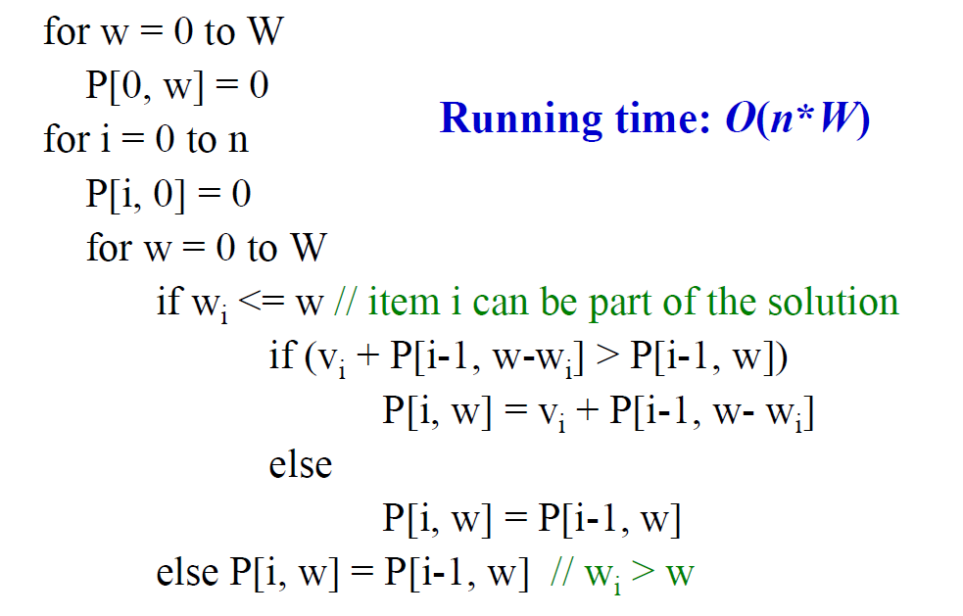
0-1 knapsack Algorithm(DP)

Slide 25
DP Coin Change

Slide 26
Problem definition
Given unlimited amounts of coins of denominations
c₁ > … > c_{d} , give change for amount M with the least number of coins.

Slide 27
Coin change problem
To find the minimum number of US coins to make any amount, the greedy method always works
At each step, just choose the largest coin that does not overshoot the desired amount: 31¢ = (25+5+1)
The greedy method would not work if we did not have 5¢ coins
For 31 cents, the greedy method gives seven coins (25+1+1+1+1+1+1), but we can do it with four (10+10+10+1)
The greedy method also would not work if we had a 21¢ coin
For 63 cents, the greedy method gives six coins (25+25+10+1+1+1), but we can do it with three (21+21+21)
The greedy algorithm results in a solution, but always not in an optimal solution
How can we find the minimum number of coins for any given coin set?

Slide 28
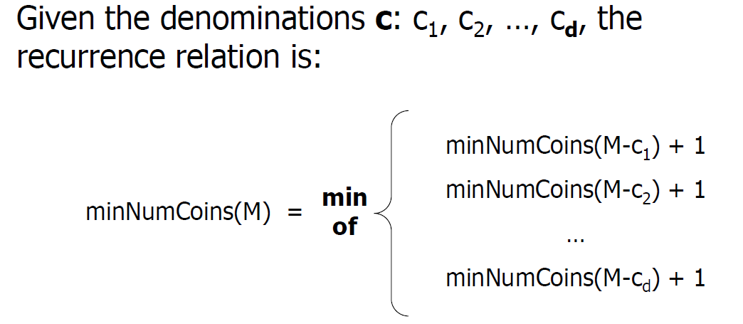
Coin change problem

Slide 29
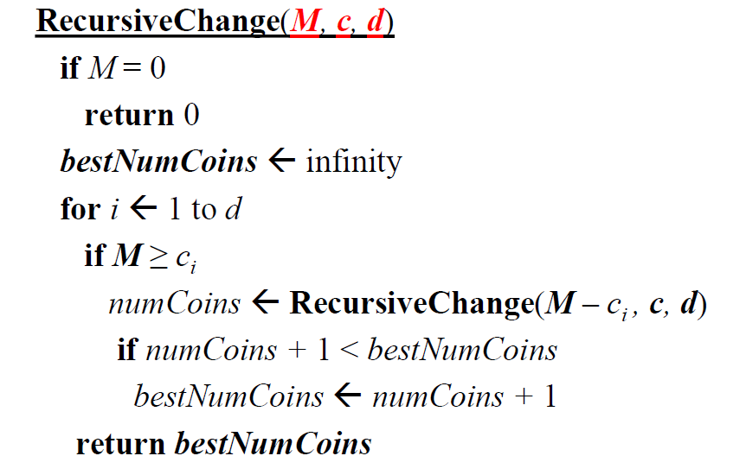
Coin change problem: Recursive algorithm
Recursive algorithm is not efficient. It recalculates the optimal coin combination for a given amount of money repeatedly

Slide 30
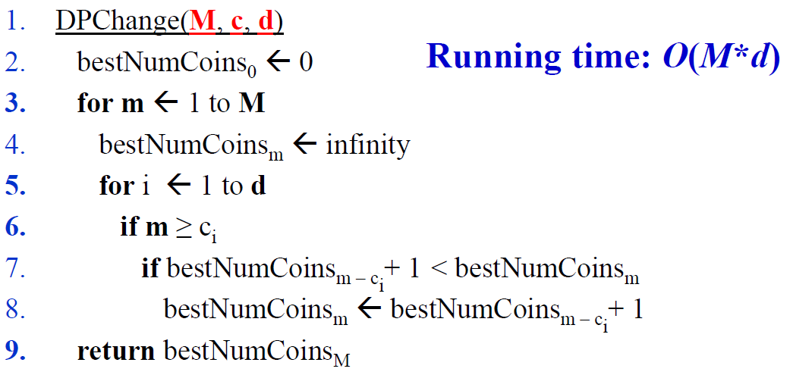
Coin change problem: DP

Slide 31
Backtracking
Consider available coins, c={1,2,6}
Changed amount, M=11
BestNumOfCoins
Chosen coins:
0 | 1 | 2 | 3 | 4 | 5 | 6 | 7 | 8 | 9 | 10 | 11
0 | 1 | 1 | 2 | 2 | 3 | 1 | 2 | 2 | 3 | 3 | 4
0 | 1 | 2 | 3 | 4 | 5 | 6 | 7 | 8 | 9 | 10 | 11
0 | 1 | 2 | 1 | 2 | 1 | 6 | 1 | 2 | 1 | 2 | 1

Slide 32
Rod cutting problem

Slide 33
Problem definition
Given a rod of length n inches and a table of prices pi for i = 1, 2, …, n, determine the maximum revenue obtainable by cutting up the rod and selling the pieces. Note that if the price p_{n} for a rod of length n is large enough, an optimal solution may require no cutting at all.
Your task is to solve the rod cutting problem using dynamic programming. Print the maximum revenue and length of each piece.
Length i |  | 1 | 2 | 3 | 6 | 10
Price p_{i} |  | 2 | 5 | 10 | 13 | 25

